Slide 1

Avoid Freezing of Gait (FoG)
Speaker (name.surname@univr.it)
Computer Science Department
University of Verona - Italy

Slide 2
Freezing of Gait (FOG)
Freezing of gait (FOG) is a common and debilitating, but largely mysterious, symptom of Parkinson's disease.
FOG is defined “as a brief episode during which patients find it impossible to generate effective forward stepping movements, in the absence a cause other than parkinsonism or higher cortical deficits. It is most commonly experienced during turning and step initiation, but also when faced with special constraint such as a doorway, stress and distraction.
Snijders, Anke H., et al. "Physiology of freezing of gait." Annals of neurology(2016).
‹#›

Slide 3
Consequences and Overcome of FOG
Focused attention and external stimuli (cues) can overcome the episode. Because of its sudden and unpredictable nature, FOG often leads to falls and injuries
Snijders, Anke H., et al. "Physiology of freezing of gait." Annals of neurology(2016).

Slide 4
FOG manifestation form
FOG presents itself in different phenomenologies. There are three subtypes: (i) shuffling with small steps, (ii) trembling in place without forward movement, or (iii) total akinesia .
In addition, the effect of special constraints (such as going through doorways or stress) differs between patients. It remains an open question whether these phenomenologies are the result of different severity or represent different pathophysiologies. Most commonly FOG occurs in the OFF state, and may well be levodopa- responsive.
Freezing of upper limbs and of speech is correlated to FOG and bears remarkable spatiotemporal similarity; however, the added postural component renders FOG a distinct phenomenon
Snijders, Anke H., et al. "Physiology of freezing of gait." Annals of neurology(2016).

Slide 5
Wearable Devices and Internet of Things (IoT)
Wearable Devices Are smart electronic devices (electronic device with microcontrollers) that can be worn on the body as implant or accessories
Wearable and IoT Wearable devices such as activity trackers are a good example of the Internet of Things, since "things" such as electronics, software, sensors and connectivity are effectors that enable objects to exchange data (including Data Quality) through internet with a manufacturer, operator and/or other connected devices, without requiring human intervention.
IoT is the inter-networking of physical devices, vehicles (also referred to as "connected devices" and "smart devices"), buildings, and other items embedded with electronics, software, sensors, actuators, and network connectivitywhich enable these objects to collect and exchange data.

Slide 6
Wearable, IoT and FOG
Current and Future Therapy for FOG (Our Goal ?)
Physiotherapy
Real Time Observation
Real Time Coaches
Physical Contact
Real Time Iteration with the Patient
Wearable Device
Real Time Observation
Real Time Coaches
No Physical Contact
IoT
Virtual Iteration Patient, Doctor and Caregiver

Slide 7
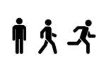
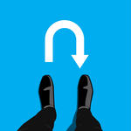
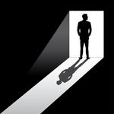


FOG Manifestation
Walking
Step initiation
Turning
New pattern on the floor
Doorway
Stress
Distraction
Talking
Standing up
……
…...

Slide 8
Goal
First (Less complex) Creation of a conjunction of devices able to detect FOG context and help the patient with PD to overcome the problem
Second (More complex) Through the aforementioned devices, Try to prevent/predict the FOG context and try to avoid it’s happening

Slide 9
Target FOG manifestation
FOG Classification based on Duration
<10s
10s<d<30s
>30s
Context before FOG manifestation
Cadence of gait rise
Incomplete shifting of the center of posture from one foot to the other
Decrease stride length
Start hesitation in the first three steps
Cognitive overload during concomitant and motor tasks
Turning
Narrow space or immediately before reaching destination
FOG Manifestation
Trembling in place, with alternating rapid knees movement
Shuffling forward, with very short, shuffling steps
Complete (or total) akinesia, with no limbs and trunk movement
Overcome FOG
Verbal/Auditory Stimuli (soldiers marching command)
Visual Stimuli (e.g. line on ground, another’s person walk)
Delval, A., et al. "Characterization and quantification of freezing of gait in Parkinson's disease: Can detection algorithms replace clinical expert opinion?." Neurophysiologie Clinique/Clinical Neurophysiology 45.4 (2015): 305-313.

Slide 10
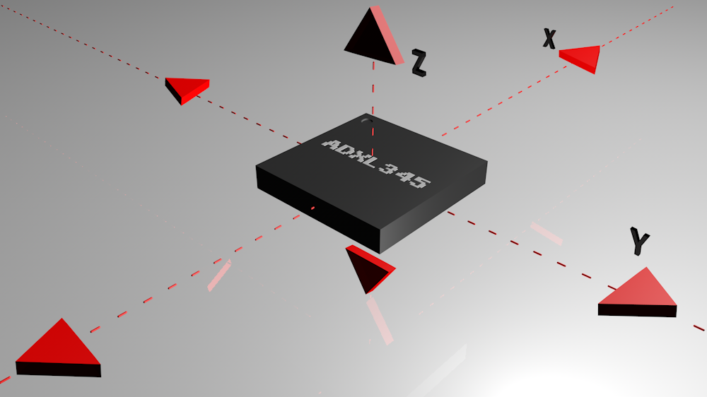
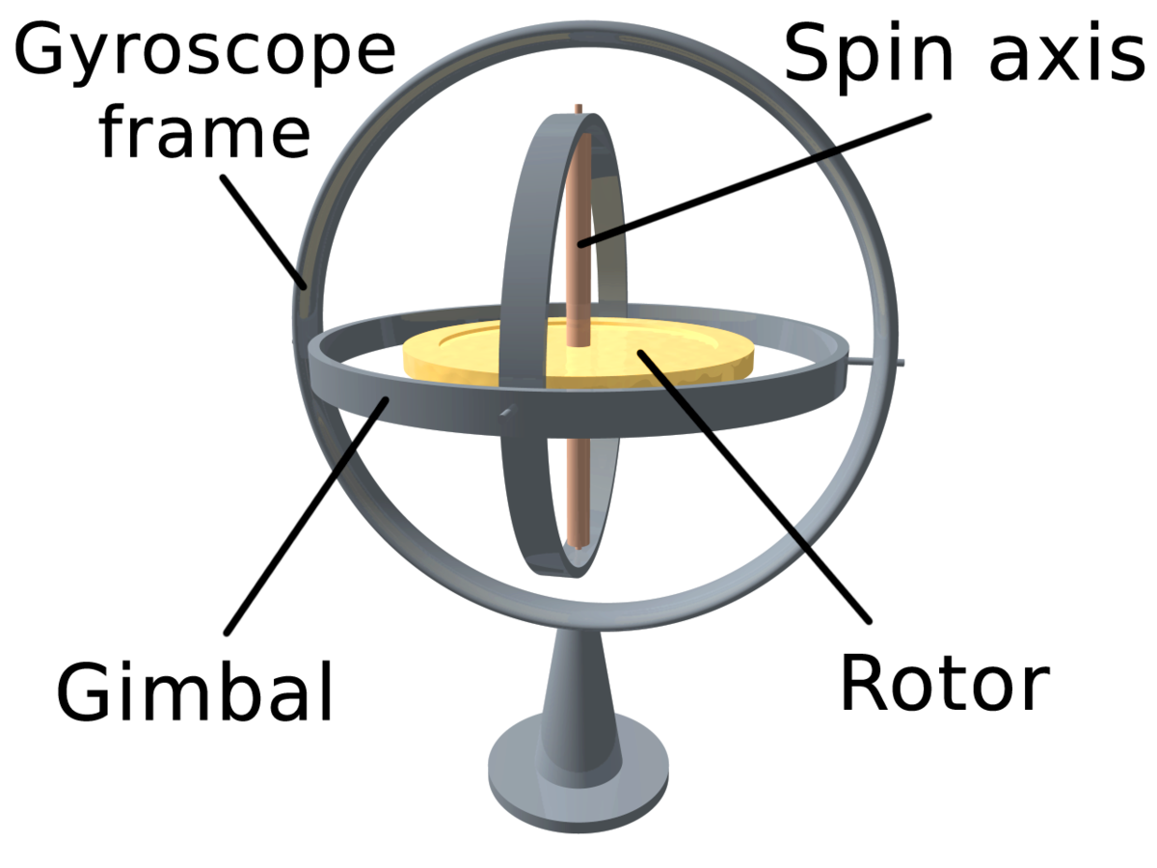
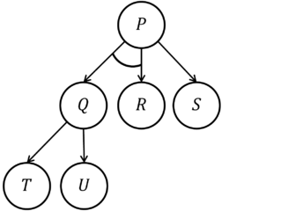
What do We Need?
Knowledge of the Context
Sensors
Accelerometer
Gyroscope
Row Data
How to use data ?
Algorithms
And/Or Tree
….
….
...

Slide 11
HW/SW Requirements and Constraints
Hardware (HW)
Sensors
Accelerometer
Gyroscope
Actuators
Audio Unit
Vibration Unit
BLE Interface
Smartphone/Embedded device
Constraints
Battery Life
Usability
Reduce Invasivity
Software (SW)
Android/iOS Developer
Communication Protocol
Scalability
Integrability
Database NoSQL
……
……
Constraints
Battery Life
Usability
Reduce Invasivity
Time of Computation
Where do we have to Compute?

Slide 12
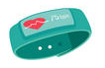


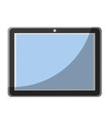
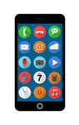

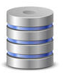
Agents
Physical Interaction
BLE
Physical Interaction
TCP/IP
TCP/IP

Slide 13
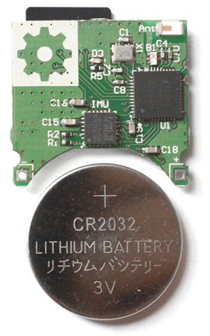
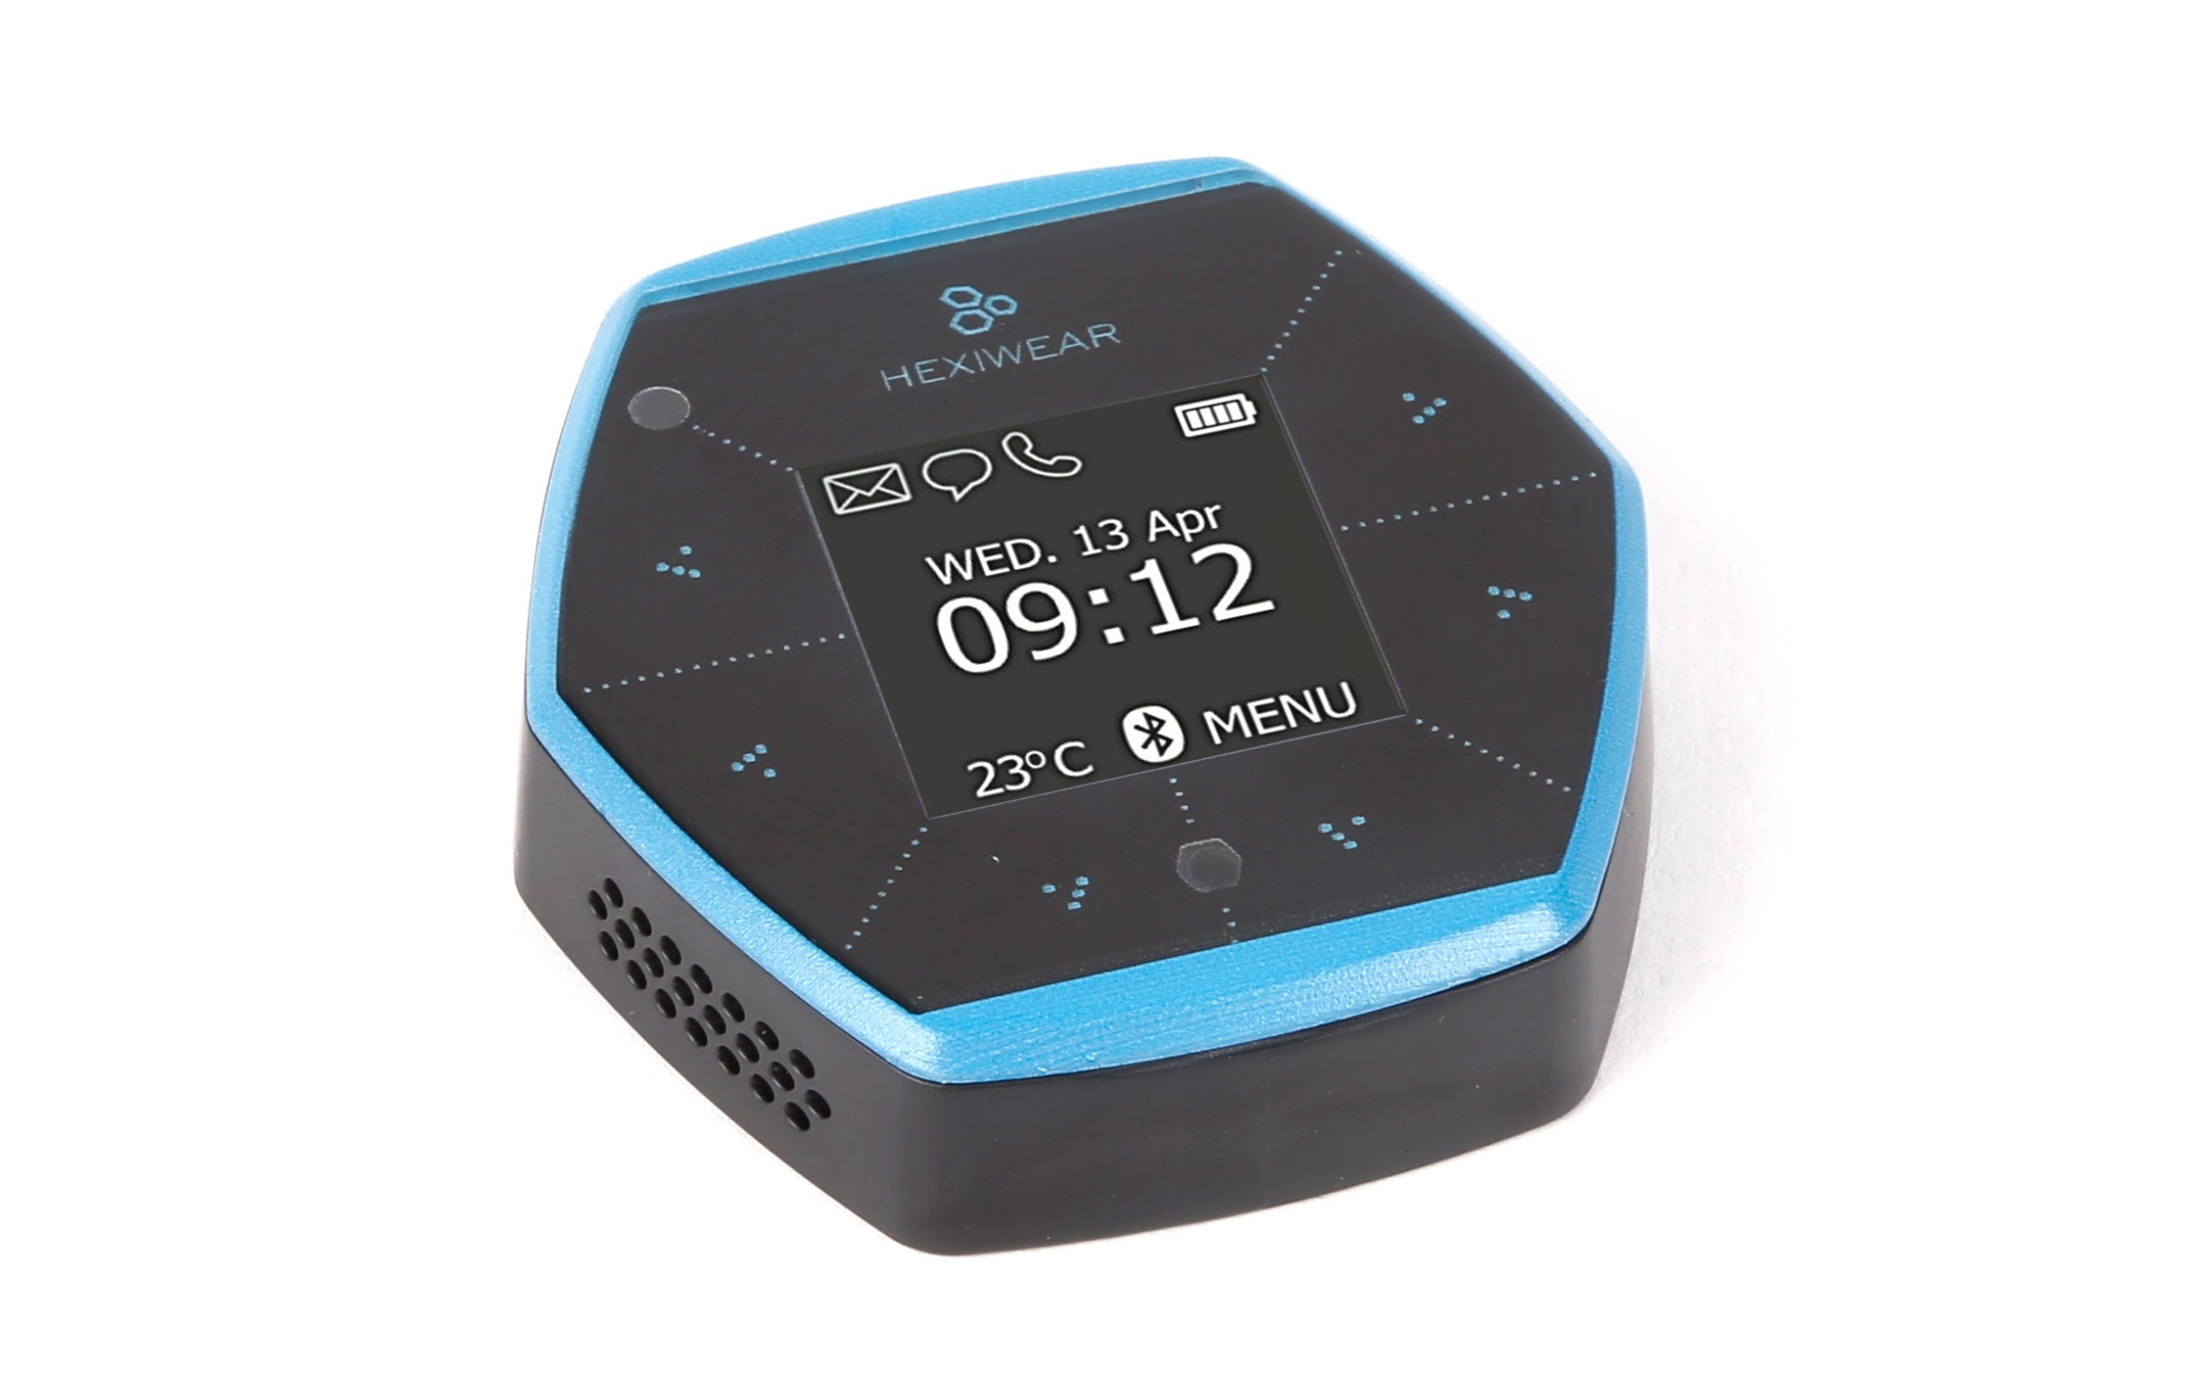
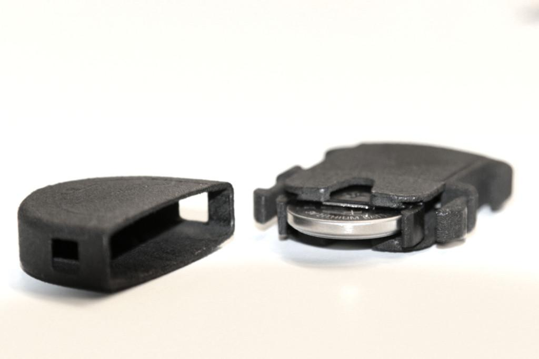
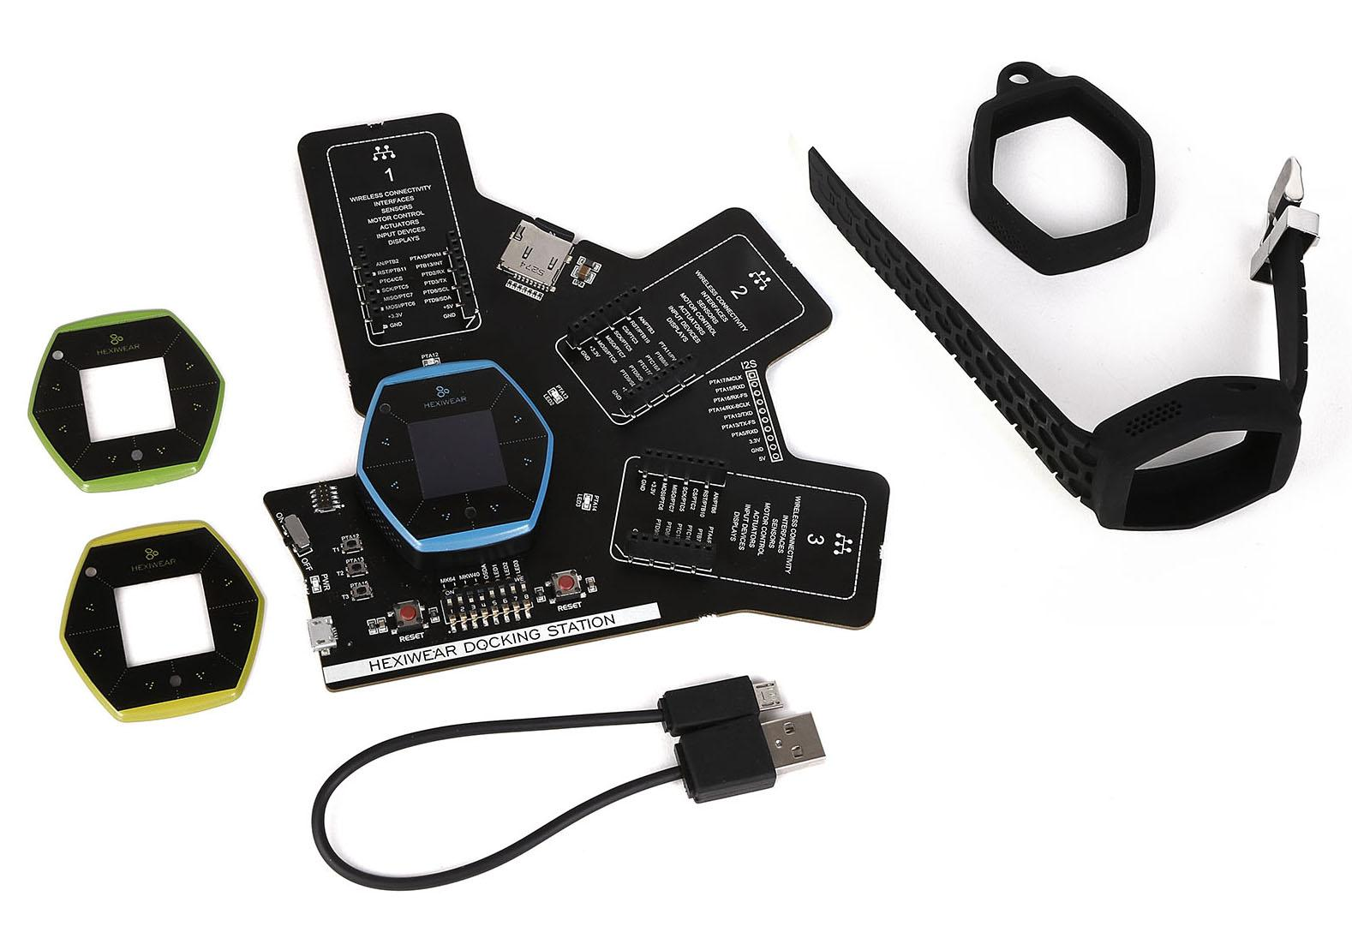
Proposed Physical Devices
Totem Open Health
ElectroCardioGram (ECG) with:
– Heart Rate Variability (HRV)
– 2 leads
MEMS: LSM9DS1
3-axis accelerometer +- 16g
3-axis gyroscope +- 2000 o/s
3-axis magnetometer +-16 Gauss
Temperature sensor (accuracy of 0.1 oC)
Microcontroller: ATSAMD21
16kB usable RAM
Bluetooth Low Energy (BLE 4.0)
MicroSD card slot.
AAA Battery
Price: On request by explaining the involved idea
Hexiwear
MCU: NXP Kinetis K64x MCU (ARM® Cortex®-M4, 120 MHz, 1M Flash, 256K SRAM)
BLE: NXP Kinetis KW4x (ARM® Cortex®-M0+, Bluetooth Low Energy & 802.15.4 Wireless MCU)
3D Accelerometer and 3D Magnetometer: NXP FXOS8700CQ
3-Axis Digital Gyroscope: NXP FXAS21002
Absolute Digital Pressure sensor: NXP MPL3115A2R1
600 mA Single-cell Li-Ion/Li-Polymer Battery Charger: NXP MC34671
Light-to-digital converter, Digital humidity and temperature sensor, Heart-rate sensor
1.1” full color OLED display
Haptic feedback engine
190 mAh 2C Li-Po battery
Capacitive touch interface
RGB LED
Price Hexiwear 49 $
Price DevKit 99$

Slide 14
Issues
FoG and pre-FoG are subject-dependent and difficult to model
Classify the movement (e.g. initiation of gait, turning, stopping, standing)
Relation between movements (events)
Succession of events (find the correct order of events, if exists)
How to use data (e.g. raw data/codified data/statistical features on data)
How many features ?
How many accelerometers ?

Slide 15
Phases
Decide the target FOG manifestation
Identification of HW component for Wearable Device (WD)
Identification of action time window
Mobile App (iOS, Android, WebApp)
Communication WD-Phone/Tablet protocol
Context Detection Algorithm
Computation (On Wearable Device, Mobile App or Server)
Definition of the Agents
Server and Data Structure
Evaluation over time of the Patient Disease

